Slide 1


Installation Guide
Smart Systems for Occupancy and Building Energy Control
SSOBEC Version 3
Team: Eduardo Castillo Mentor: Ali Mostafavi, Leonardo Bobadilla
Notes:
Greetings!
This is the installation guide for the Smart Systems for Occupancy And Building Energy Control Project version 2.
The team is composed of Diana Leante Bone and Irvin Steve Cardenas.
Under the supervision of Dr. Ali Mostafavi and Dr. Leonardo Bobadilla.

Slide 2
Pre-requisites
Software and hardware required in development environment:
> Development Environment:
1. Mac OS 10.7+, Windows 7+, or Ubuntu 14.0 +
2. Android Studio 1.2.1.x
3. Android SDK API Levels 16 – 22
> Android Device with Android 4.1
Software required in remote host server environment:
> Linux Distribution OS (Ubuntu 14.x, Cent OS,..)
> LAMP (Linux, Apache, MySQL PHP5) stack
> PHP Mailer Library
Notes:
The software pre-requisites are split into 2 sections.
The software required for the development environment and the software required in the remote host environment
The development environment can run on a MacOS 10.7 and above, a Windows 7 machine or above or an Ubuntu 14.0 and above. These operating system version support the other software required to run the application..
The Development environment is also required to have Android Studio 1.2.1 and above installed as well as the Android SDK API Libraries for level 16-22.
On the remote host server, the server that will host or web service to interact with the database should be any Linux distribution that supports the LAMP stack.
In our case we chose to stick with an Ubuntu server.
The pieces of software required are the LAMP stack (Linux, Apache, MySQL and PHP software, and PHP Mailer Library.

Slide 3
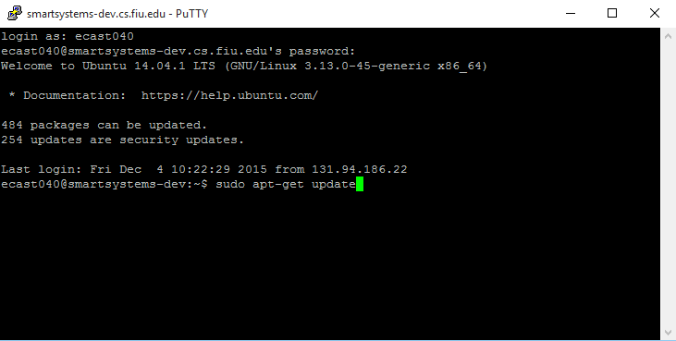
Setting up the database in the server
Notes:
Assuming that we have installing the Linux Operating system in an external machine. You may perform the update commands

Slide 4
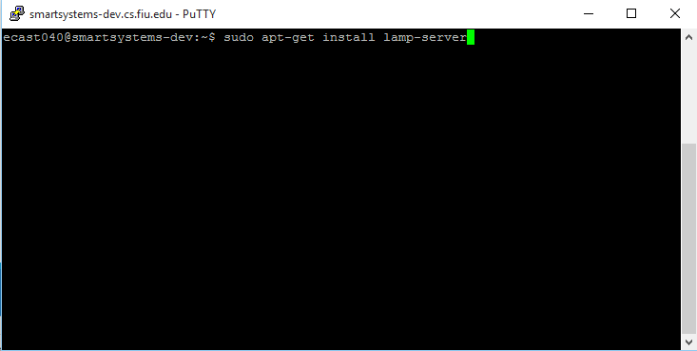
Install LAMP stack
Notes:
Execute a LAMP stack installation by typing in the command line sudo apt-get install lamp-server

Slide 5
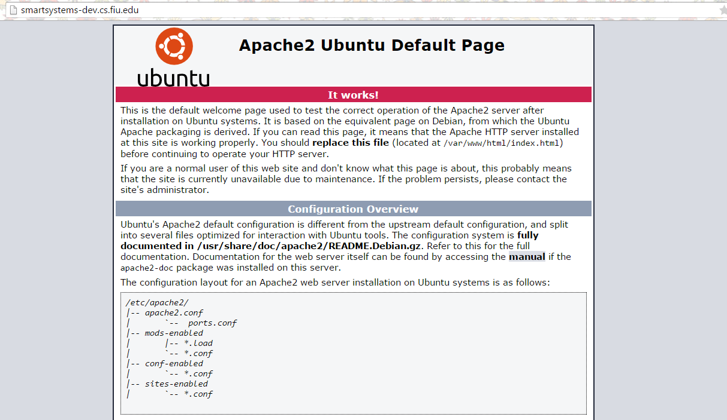
Notes:
This is the page you must see in your domain name

Slide 6
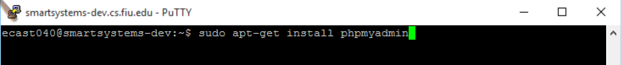
Run The Following Commands to Install Phpmyadmin
Notes:
Once you have made sure the LAMP server has been installed.
Install PHPMyAdmin, a graphical user interface to interact with the database.

Slide 7
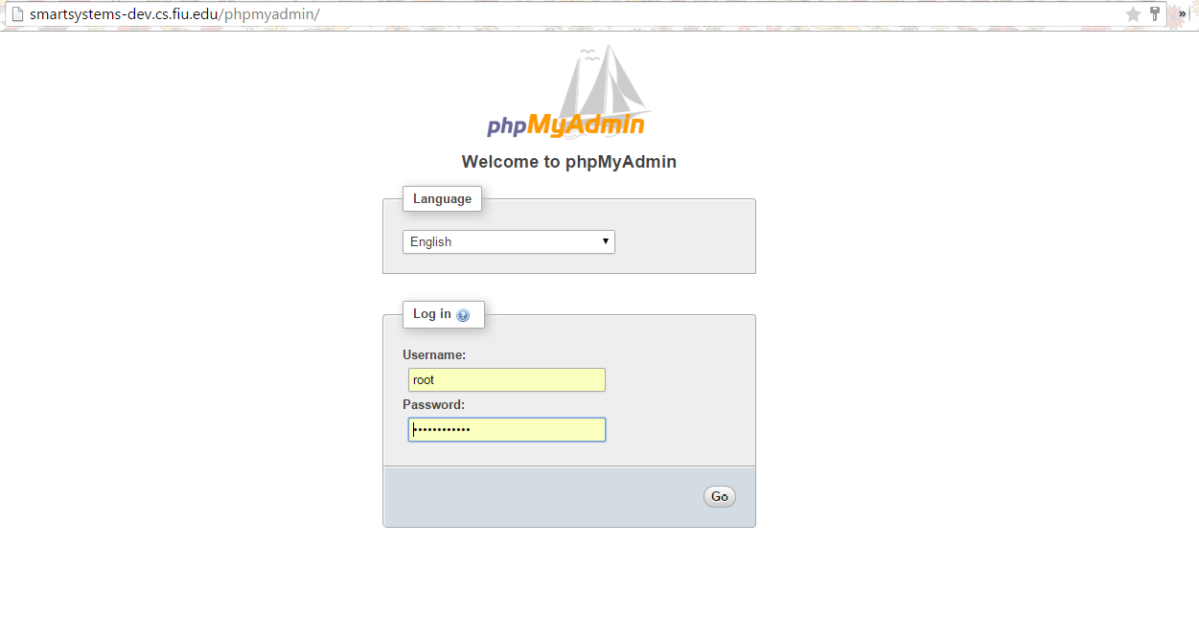
Notes:
Once PHP Admin is installed. You should see the following page.
Log in.

Slide 8
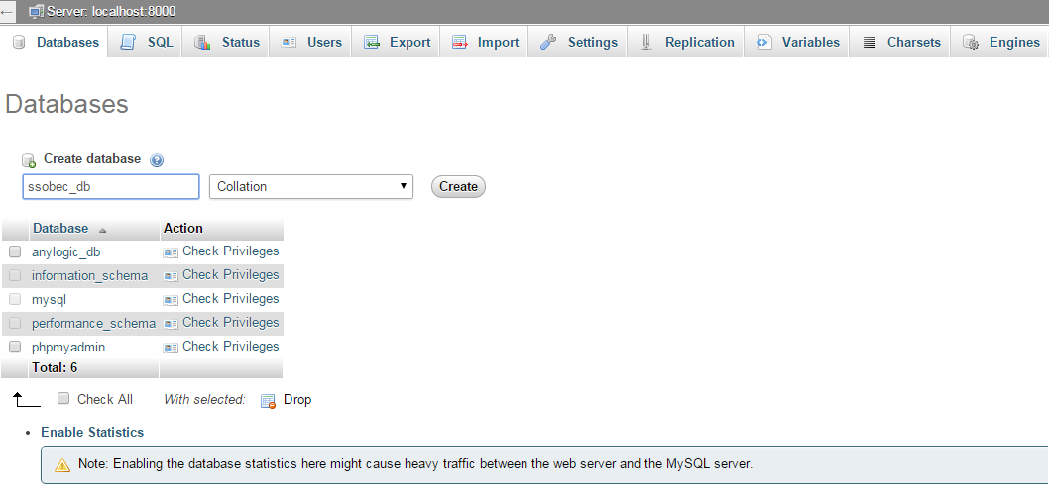
Notes:
If you are working on a fresh environment. You will need to create and import that database contain the app information.
Create a database title ssobec_db.

Slide 9
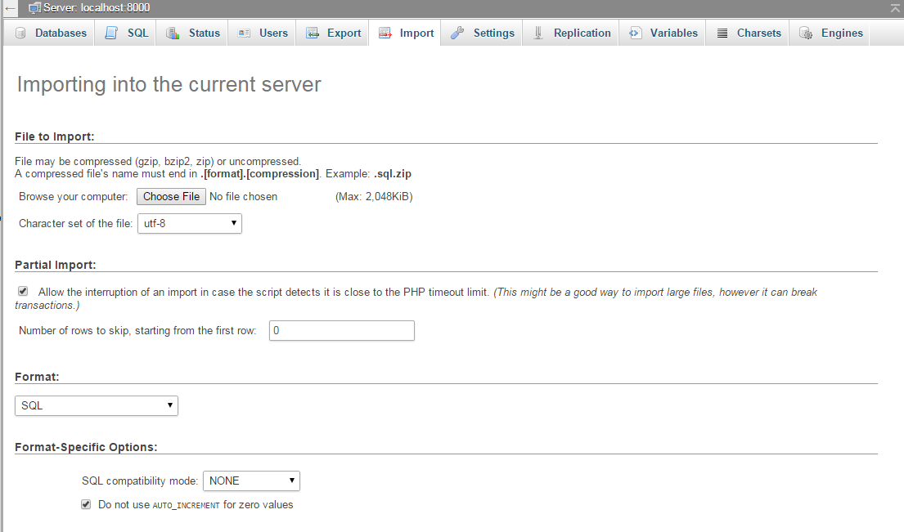
Notes:
Then select the import tab and click on choose file and select the database file.

Slide 10
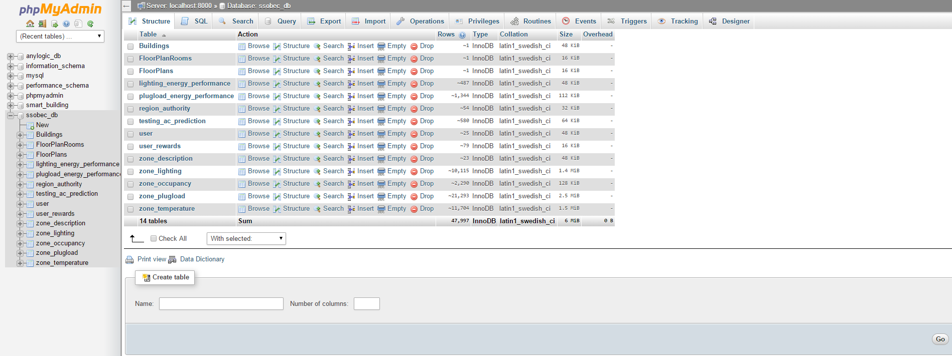
Notes:
Once the database has been imported. You shall see the following tables.

Slide 11
Installing the Mobile Application
Notes:
This section of the video describes the steps to install the Android Mobile Application.

Slide 12
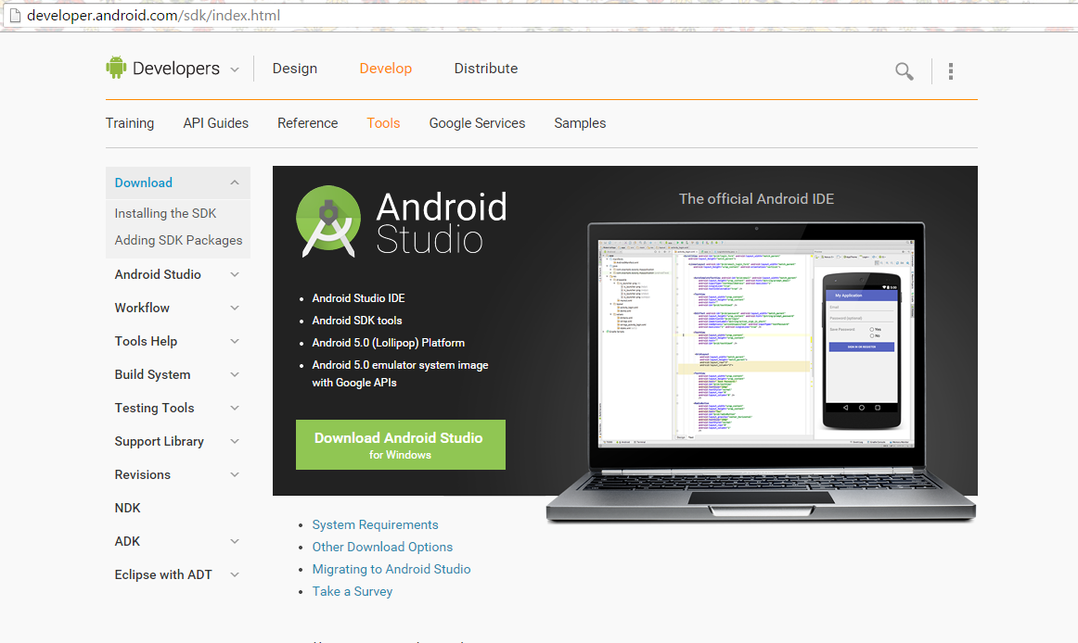
Notes:
First you will need to install Android Studio in your development environment.
Go to www.developer.android.com/ to download Android Studio

Slide 13
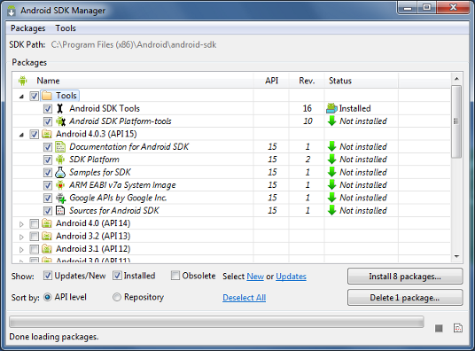
Notes:
Next you will need to install the Android API Level 15 and above packages.

Slide 14
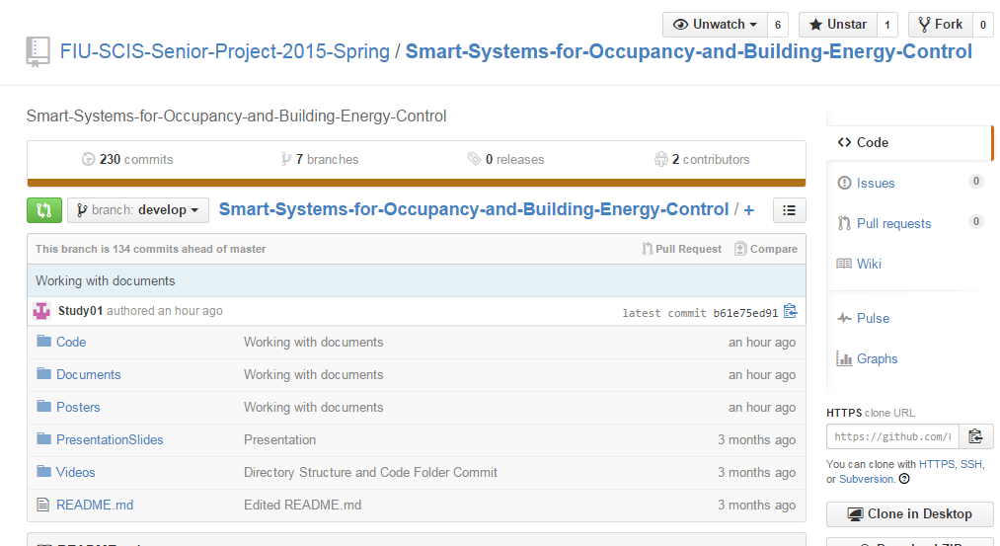
Notes:
Next you need to visit the Smart Systems for Occupancy and Building Energy Control GitHub Repository and clone the repostory

Slide 15
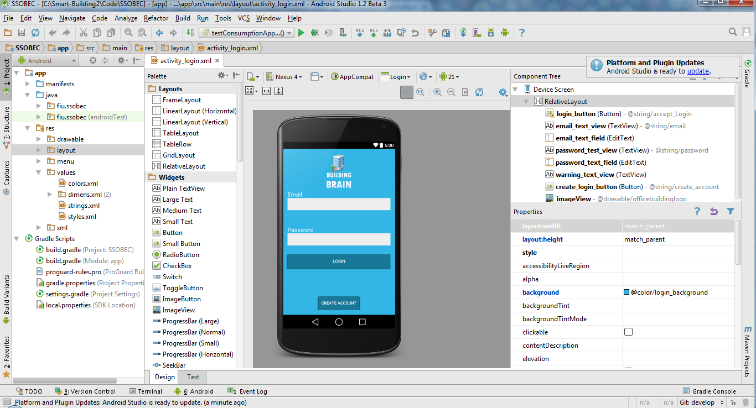
Notes:
Once you have cloned the repository you can open the project using Android Studio

